Slide 1
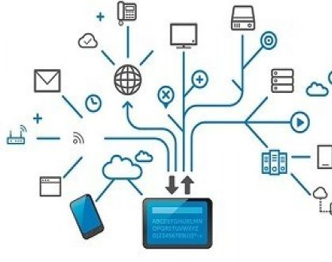
Week 2 - Lecture
ACN – Application Layer
enda.stafford@ncirl.ie

Slide 2





Agenda - Datatypes
Principles of network applications
Web and HTTP
Video streaming and CDN
The Domain Name System - DNS
HTTP Caching

Slide 3

Principles of network applications

Slide 4
What is the Application Layer
The Application Layer provides protocols that allow software to send and receive information and present meaningful data to users
Human Computer Interaction Layer
Main Functions:
  Identifying Communication Partners
  Determining Resource Availability
  Synchronizing Communication
HTTP Web
DNS
Social Networking
Email Services
Video Streaming
P2P file sharing
Multiplayer Gaming
Remote Login
Network Virtual Terminal

Slide 5
Two Important Concepts
Application Layer
First step in getting data on to the network
Application Layer Software
The programs used to communication over the network
Example: Displaying a web page
Application Layer uses the HTTP protocol
The Application Software is your browser

Slide 6



Benefits of Application layer abstraction
write programs that:
  run on (different) end systems
  communicate over network
  e.g., web server software communicates with browser software
no need to write software for network-core devices
  network-core devices do not run user applications
  applications on end systems allows for rapid app development, propagation
application
transport
network
data link
physical
application
transport
network
data link
physical
application
transport
network
data link
physical

Slide 7

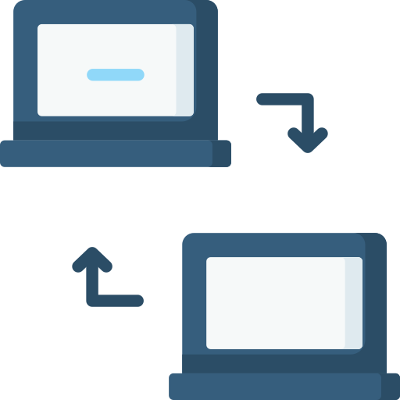
Application Layer Architectures
Client Server
Peer to Peer
Hybrid of these two

Slide 8
Client-server architecture
server:
  always-on host
  permanent IP address
  often in data centers, for scaling
clients:
  contact, communicate with server
  may be intermittently connected
  may have dynamic IP addresses
  do not communicate directly with each other
  examples: HTTP, IMAP (Internet Message Access Protocol), FTP

Slide 9
Peer to Peer architecture
no always-on server
arbitrary end systems directly communicate
peers request service from other peers, provide service in return to other peers
  self scalability – new peers bring new service capacity, as well as new service demands
peers are intermittently connected and change IP addresses
complex management

Slide 10
Application Layer Processes
A process is program running within a host
A host can run multiple processes (or services)
These processes communication with messages
  Client – initiates
  Server – responds
  P2P – has both client and server processes
Identified by IP address and port number
  HTTP server: 80
  Mail server: 25

Slide 11
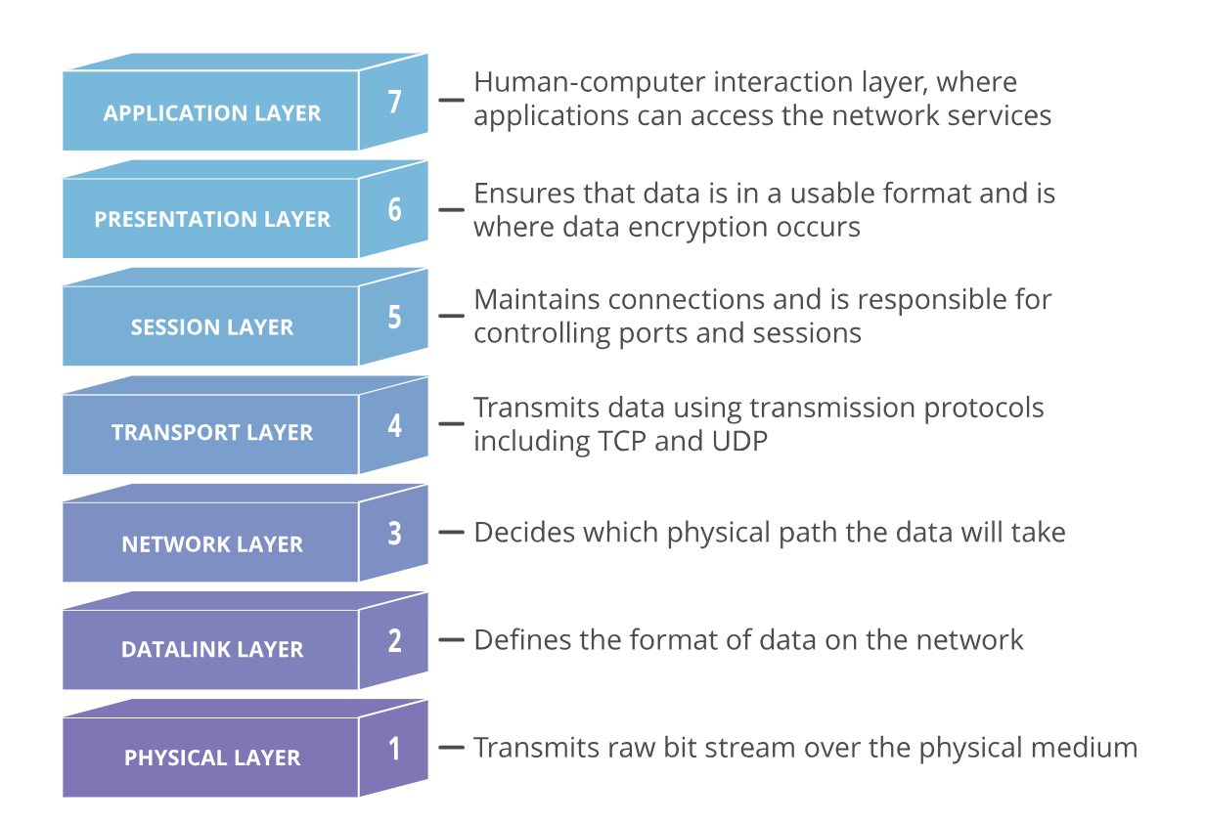

Slide 12
Applications – Transport Requirements
Data Integrity
Some apps require 100% reliable (file transfer)
Some are loss tolerant (audio/video)
Throughput
Minimum for effectiveness (video)
Elastic – use whatever they get
Timing
Low delay apps (gaming)
Security
Encryption, data integrity etc

Slide 13
App Layer - Transport Protocols Services
TCP Transmission Control Protocol
UDP: User Datagram Protocol
unreliable data transfer between sending and receiving process
reliable transport between sending and receiving process
flow control: sender won’t overwhelm receiver
congestion control: throttle sender when network overloaded
connection-oriented: setup required between client and server processes
does not provide: timing, minimum throughput guarantee, security
does not provide: reliability, flow control, congestion control, timing, throughput guarantee, security, or connection setup.

Slide 14
Ports are a transport layer (layer 4) concept. Only a transport protocol such as the Transmission Control Protocol (TCP) or User Datagram Protocol (UDP) can indicate which port a packet should go to.
There are 65,535 possible port numbers, although not all are in common use. Some of the most commonly used ports, along with their associated networking protocol, are:
Ports 20 and 21: File Transfer Protocol (FTP). FTP is for transferring files between a client and a server.
Port 22: Secure Shell (SSH). SSH is one of many tunneling protocols that create secure network connections.
Port 25: Historically, Simple Mail Transfer Protocol (SMTP). SMTP is used for email.
Port 53: Domain Name System (DNS). DNS is an essential process for the modern Internet; it matches human-readable domain names to machine-readable IP addresses, enabling users to load websites and applications without memorizing a long list of IP addresses.

Slide 15
Internet applications, and transport protocols
application
layer protocol
FTP [RFC 959]
SMTP [RFC 5321]
HTTP 1.1 [RFC 7320]
SIP [RFC 3261], RTP [RFC 3550], or proprietary HTTP [RFC 7320], DASH
WOW, FPS (proprietary)
application
file transfer/download
e-mail
Web documents
Internet telephony
streaming audio/video
interactive games
transport protocol
TCP
TCP
TCP
TCP or UDP
TCP
UDP or TCP
Notes:
FPS - FairPlay Streaming....Apple

Slide 16
Securing TCP
Vanilla TCP & UDP sockets:
no encryption
cleartext passwords sent into socket, traverse Internet in cleartext (!)
Transport Layer Security (TLS)
provides encrypted TCP connections
data integrity
end-point authentication
TLS implemented in application layer
apps use TLS libraries, that use TCP in turn
cleartext sent into “socket”, traverse Internet encrypted

Slide 17
Exercise
Rapid Research

Slide 18
Exercise – Rapid Research
Group Num | Subject | Suggested Topics
Group 1 | Web and HTTP | Protocols, connection types, caching, response times, HTTP2
Group 2 | DNS | Root DNS, record types, security, Load balancing
Group 3 | Video Streaming and CDNs | Impact of video on internet tech, bitrates, CDNs, challenges, streaming protocols
Do this in Groups
Time limit – 15 mins
Present findings – 5 mins (or less)

Slide 19
Web and HTTP

Slide 20

HTTP overview
HTTP: hypertext transfer protocol
Web’s application-layer protocol
client/server model:
  client: browser that requests, receives, (using HTTP protocol) and “displays” Web objects
  server: Web server sends (using HTTP protocol) objects in response to requests
HTTP uses TCP:
  client initiates TCP connection (creates socket) to server, port 80
  server accepts TCP connection from client
  HTTP messages (application-layer protocol messages) exchanged between browser (HTTP client) and Web server (HTTP server)
  TCP connection closed
HTTP request
HTTP request
HTTP response
HTTP response

Slide 21
HTTP connections: two types
Non-persistent HTTP
  TCP connection opened
  at most one object sent over TCP connection
  TCP connection closed
  downloading multiple objects required multiple connections
Persistent HTTP
  TCP connection opened to a server
  multiple objects can be sent over single TCP connection between client, and that server
  TCP connection closed

Slide 22
Three-way handshake
Client begins in a CLOSED state
Server begins in a LISTEN state
Client SYN sent – x = 999
Server SYN + ACK
  Ack = x + 1 = 1000
  SYN = 100
Client ACK
  Ack = y + 1 = 101
Client
Server
SYN, Sequence Num = x
SYN + ACK, Sequence Num = y
Acknowledgement = x + 1
Acknowledgement = y + 1
Notes:
1. The initial state on the initiator is CLOSED and, on the recipient, it is LISTEN (the recipient is waiting for a connection see figure 24.7).
2.The initiator goes into the SYN-SENT state and sends a packet with the SYN bit set and then indicates that the starting sequence number will be 999 (the current sequence number, thus the next number sent will be 1000). When this is received the recipient goes into the SYN-RECEIVED state.
3.The recipient sends back a TCP packet with the SYN and ACK bits set (which identifies that it is a SYN packet and also that it is acknowledging the previous SYN packet). In this case, the recipient tells the originator that it will start transmitting at a sequence number of 100. The acknowledgement number is 1000, which is the sequence number that the recipient expects to receive next. When this is received, the originator goes into the ESTABLISHED state.
4.The originator sends back a TCP packet with the SYN and ACK bits set and the acknowledgement number is 101, which is the sequence number it expects to see next.
5.The originator transmits data with the sequence number of 1000.

Slide 23
HTTP connections: two types round trip time (RTT) in milliseconds
Non-persistent (HTTP 1.0)
Persistent (HTTP 1.1)
Initiate connection
Initiate connection
RTT
RTT
Request Object
Request Object
RTT
File Transmit time
RTT
File Transmit time
File received
New TCP Connection
File received
Request Objects
RTT
RTT
File Transmit time
Request Object
File Received
RTT
File Transmit time
File received
Notes:
1a. HTTP client initiates TCP connection to HTTP server (process) at www.someSchool.edu on port 80
1b. HTTP server at host www.someSchool.edu waiting for TCP connection at port 80 “accepts” connection, notifying client
2. HTTP client sends HTTP request message (containing URL) into TCP connection socket. Message indicates that client wants object someDepartment/home.index
3. HTTP server receives request message, forms response message containing requested object, and sends message into its socket
4. HTTP server closes TCP connection.
5. HTTP client receives response message containing html file, displays html. Parsing html file, finds 10 referenced jpeg objects
6. Steps 1-5 repeated for each of 10 jpeg objects

Slide 24
HTTP Response Time
Non-Persistent
2RTT + Object Transmission time
Persistent
As little as 1RTT+Transmission time
Example: 10 requests
Non-Persistent – 20 RTT + 10 data transmission
Persistent – 3RTT + 10 data transmission

Slide 25
Other HTTP request messages
POST method:
  web page often includes form input
  user input sent from client to server in entity body of HTTP POST request message
GET method (for sending data to server):
  include user data in URL field of HTTP GET request message (following a ‘?’):
HEAD method:
  requests headers (only) that would be returned if specified URL were requested with an HTTP GET method.
PUT method:
  uploads new file (object) to server
  completely replaces file that exists at specified URL with content in entity body of POST HTTP request message

Slide 26
HTTP request message
two types of HTTP messages: request, response
HTTP request message:
  ASCII (human-readable format)
carriage return character
request line (GET, POST,
HEAD commands)
line-feed character
GET /index.html HTTP/1.1\r\n
Host: www-net.cs.umass.edu\r\n
User-Agent: Mozilla/5.0 (Macintosh; Intel Mac OS X 10.15; rv:80.0) Gecko/20100101 Firefox/80.0 \r\n
Accept: text/html,application/xhtml+xml\r\n
Accept-Language: en-us,en;q=0.5\r\n
Accept-Encoding: gzip,deflate\r\n
Connection: keep-alive\r\n
\r\n
header
lines
carriage return, line feed at start of line indicates end of header lines
* Check out the online interactive exercises for more examples: http://gaia.cs.umass.edu/kurose_ross/interactive/

Slide 27
HTTP response message
status line (protocol
status code status phrase)
HTTP/1.1 200 OK
Date: Tue, 08 Sep 2020 00:53:20 GMT
Server: Apache/2.4.6 (CentOS) OpenSSL/1.0.2k-fips PHP/7.4.9 mod_perl/2.0.11 Perl/v5.16.3
Last-Modified: Tue, 01 Mar 2016 18:57:50 GMT
ETag: "a5b-52d015789ee9e"
Accept-Ranges: bytes
Content-Length: 2651
Content-Type: text/html; charset=UTF-8
\r\n
data data data data data ...
header
lines
* Check out the online interactive exercises for more examples: http://gaia.cs.umass.edu/kurose_ross/interactive/

Slide 28
Web Caching

Slide 29


Web caches
Goal: satisfy client requests without involving origin server
user configures browser to point to a (local) Web cache
browser sends all HTTP requests to cache
  if object in cache: cache returns object to client
  else cache requests object from origin server, caches received object, then returns object to client
Web
cache
HTTP request
HTTP request
client
HTTP response
HTTP response
origin
server
HTTP request
HTTP response
client

Slide 30


Web caches (aka proxy servers)
Web cache acts as both client and server
  server for original requesting client
  client to origin server
Why Web caching?
reduce response time for client request
  cache is closer to client
reduce traffic on an institution’s access link
Internet is dense with caches
  enables “poor” content providers to more effectively deliver content
server tells cache about object’s allowable caching in response header:
Notes:
re: poor content providers – like in real-estate, location is everything. servers want to be close to clients.

Slide 31



Caching example
Scenario:
access link rate: 1.54 Mbps
RTT from institutional router to server: 2 sec
web object size: 100K bits
average request rate from browsers to origin servers: 15/sec
  avg data rate to browsers: 1.50 Mbps
origin
servers
public
Internet
1.54 Mbps
access link
Performance:
access link utilization = .97
LAN utilization: .0015
end-end delay = Internet delay +
access link delay + LAN delay
= 2 sec + minutes + usecs
problem: large queueing delays at high utilization!
institutional
network
1 Gbps LAN
Notes:
explain why minutes (recall earlier delay versus arrival rate curve from Chapter 1)

Slide 32
HTTP 2.0

Slide 33
HTTP/2
Key goal: decreased delay in multi-object HTTP requests
HTTP1.1: introduced multiple, pipelined GETs over single TCP connection
  server responds in-order (FCFS: first-come-first-served scheduling) to GET requests
  with FCFS, small object may have to wait for transmission (head-of-line (HOL) blocking) behind large object(s)
  loss recovery (retransmitting lost TCP segments) stalls object transmission
Notes:
t’

Slide 34
HTTP/2
Key goal: decreased delay in multi-object HTTP requests
HTTP/2: [RFC 7540, 2015] increased flexibility at server in sending objects to client:
  methods, status codes, most header fields unchanged from HTTP 1.1
  transmission order of requested objects based on client-specified object priority (not necessarily FCFS)
  push unrequested objects to client
  divide objects into frames, schedule frames to mitigate HOL blocking

Slide 35
Head-of-line blocking or HOL blocking is a generic term in computer science that refers to a performance-limiting phenomenon that occurs when a line of packets is held up by the first packet.
It can occur in network devices, transport protocols (for eg, in HTTP pipelining), or distributed systems (for e.g., slow consumption of a message from a kafka topic partition).
https://kafka.apache.org/intro

Slide 36
HTTP/2: mitigating HOL blocking
HTTP 1.1: client requests 1 large object (e.g., video file) and 3 smaller objects
server
GET O₄
GET O₃
GET O₂
GET O₁
object data requested
client
O₁
O₂
O₁
O₃
O₂
O₃
O₄
O₄
objects delivered in order requested: O₂, O₃, O₄ wait behind O₁
Notes:
t’

Slide 37
HTTP/2: mitigating HOL blocking
HTTP/2: objects divided into frames, frame transmission interleaved
server
GET O₄
GET O₃
GET O₂
GET O₁
object data requested
client
O₂
O₄
O₃
O₁
O₂
O₃
O₄
O₁
O₂, O₃, O₄ delivered quickly, O₁ slightly delayed
Notes:
shortest job first: decreased average delay!

Slide 38
HTTP/2 to HTTP/3
HTTP/2 over single TCP connection means:
recovery from packet loss still stalls all object transmissions
  as in HTTP 1.1, browsers have incentive to open multiple parallel TCP connections to reduce stalling, increase overall throughput
no security over vanilla TCP connection
HTTP/3: adds security, per object error- and congestion-control (more pipelining) over UDP
  more on HTTP/3 in transport layer
Notes:
t’

Slide 39
Email and SMTP

Slide 40
E-mail
user
agent
Three major components:
user agents
mail servers
simple mail transfer protocol: SMTP
User Agent
a.k.a. “mail reader”
composing, editing, reading mail messages
e.g., Outlook, iPhone mail client
outgoing, incoming messages stored on server
mail
server
user
agent
SMTP
mail
server
user
agent
SMTP
SMTP
user
agent
mail
server
user
agent
user
agent
outgoing
message queue
user mailbox

Slide 41
E-mail: mail servers
user
agent
mail servers:
mailbox contains incoming messages for user
message queue of outgoing (to be sent) mail messages
SMTP protocol between mail servers to send email messages
client: sending mail server
“server”: receiving mail server
mail
server
user
agent
SMTP
mail
server
user
agent
SMTP
SMTP
user
agent
mail
server
user
agent
user
agent
outgoing
message queue
user mailbox

Slide 42
SMTP RFC (5321)
“client”
SMTP server
“server”
SMTP server
uses TCP to reliably transfer email message from client (mail server initiating connection) to server, port 25
  direct transfer: sending server (acting like client) to receiving server
three phases of transfer
  SMTP handshaking (greeting)
  SMTP transfer of messages
  SMTP closure
command/response interaction (like HTTP)
  commands: ASCII text
  response: status code and phrase
initiate TCP
connection
RTT
TCP connection
initiated
220
SMTP handshaking
HELO
250 Hello
SMTP transfers
time

Slide 43
SMTP: observations
comparison with HTTP:
HTTP: client pull
SMTP: client push
both have ASCII command/response interaction, status codes
HTTP: each object encapsulated in its own response message
SMTP: multiple objects sent in multipart message
SMTP uses persistent connections
SMTP requires message (header & body) to be in 7-bit ASCII
SMTP server uses CRLF. CRLF to determine end of message

Slide 44
Domain Name System

Slide 45
Domain Name System - Principles
people: many identifiers:
PPSN, name, passport #
Internet hosts, routers:
IP address (32 bit) - used for addressing datagrams
Hostname, e.g., rte.ie - used by humans
Domain Name System (DNS):
distributed database implemented in hierarchy of many name servers
application-layer protocol: hosts, DNS servers communicate to resolve names (address/name translation)
note: core Internet function, implemented as application-layer protocol

Slide 46
DNS: (Domain Name System) services, structure
DNS services:
  hostname-to-IP-address translation
  host aliasing
    canonical, alias names
  mail server aliasing
  load distribution
    replicated Web servers: many IP addresses correspond to one name
Question:
  Why not a centralised DNS?
between January 2016 and September 2021, overall traffic volume on DNS servers worldwide have increased by 100%
Notes:
Q: Why not centralize DNS?
single point of failure
traffic volume
distant centralized database
Maintenance
A: doesn‘t scale!
Comcast DNS servers alone: 600B DNS queries/day
Akamai DNS servers alone: 2.2T DNS queries/day
Google servers alone – Over a Trillion DNS queries per day
Google only serves around 10% or internet DNS traffic

Slide 47
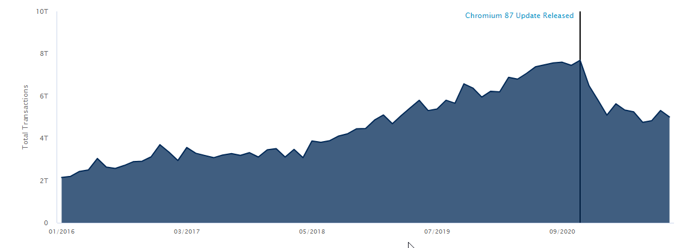
Thinking about the DNS
humongous distributed database:
  billions records, each simple
handles many trillions of queries/day:
  many more reads than writes
  performance matters: almost every Internet transaction interacts with DNS - msecs count!
organizationally, physically decentralized:
  millions of different organizations responsible for their records
Impact of Browsers
  Chromium 87
Source https://www.akamai.com/internet-station/traffic-map
Notes:
Details on the Chromium 87 update and its importance to the DNS community: Chromium is an open-source web browser developed by the Google-sponsored Chromium project. It is used as the base code for the more popular and feature-rich Google Chrome browser. As such, Chromium code is responsible for handling a very large portion of daily web requests from internet users. Prior to version 87, Chromium source code contained functionality that would send many lookup requests to DNS root servers that were considered unnecessary or “junk” requests. These requests largely existed to determine if an entry into the address bar was a URL lookup or a search term. On November 17, 2020, Chromium 87 was released. In this version, the developers had removed the code responsible for sending these types of requests. As the release was adopted, global DNS lookups started to drop and by January 2021 were down more than 40% across the DNS root servers.

Slide 48
DNS: a distributed, hierarchical database
Client wants IP address for www.amazon.com; 1st approximation:
  client queries root server to find .com DNS server
  client queries .com DNS server to get amazon.com DNS server
  client queries amazon.com DNS server to get IP address for www.amazon.com
Root DNS Servers
Root (13 root servers)
…
…
.com DNS servers
.org DNS servers
.edu DNS servers
Top Level Domain
…
…
…
…
yahoo.com
DNS servers
amazon.com
DNS servers
pbs.org
DNS servers
nyu.edu
DNS servers
umass.edu
DNS servers
Authoritative
Notes:
official, contact-of-last-resort by name servers that can not resolve name
incredibly important Internet function
Internet couldn’t function without it!
DNSSEC – provides security (authentication, message integrity)
ICANN (Internet Corporation for Assigned Names and Numbers) manages root DNS domain
13 logical root name “servers” worldwide each “server” replicated many times (~200 servers in US)
Top-Level Domain (TLD) servers:
responsible for .com, .org, .net, .edu, .aero, .jobs, .museums, and all top-level country domains, e.g.: .cn, .uk, .fr, .ca, .jp
Network Solutions: authoritative registry for .com, .net TLD
Educause: .edu TLD
authoritative DNS servers:
organization’s own DNS server(s), providing authoritative hostname to IP mappings for organization’s named hosts
can be maintained by organization or service provider

Slide 49
DNS name resolution
root DNS server
2
3
TLD DNS server
1
4
Iterative
  contacted server replies with name of server to contact
  “I don’t know this name, but ask this server
Recursive
  puts burden of name resolution on contacted name server
  heavy load at upper levels of hierarchy?
8
5
requesting host at
engineering.nyu.edu
local DNS server
dns.nyu.edu
7
6
gaia.cs.umass.edu
authoritative DNS server
dns.cs.umass.edu
root DNS server
2
3
TLD DNS server
7
6
1
5
4
8
gaia.cs.umass.edu
requesting host at
engineering.nyu.edu
local DNS server
dns.nyu.edu
authoritative DNS server
dns.cs.umass.edu

Slide 50
DNS records
type=A
name is hostname
value is IP address
type=NS
name is domain (e.g., foo.com)
value is hostname of authoritative name server for this domain
type=CNAME
name is alias name for some “canonical” (the real) name
www.ibm.com is really servereast.backup2.ibm.com
value is canonical name
type=MX
value is name of SMTP mail server associated with name
DNS: distributed database storing resource records (RR)
RR format: (name, value, type, ttl)

Slide 51
DNS security
DDoS attacks
bombard root servers with traffic
  not successful to date
  traffic filtering
  local DNS servers cache IPs of TLD servers, allowing root server bypass
bombard TLD servers
  potentially more dangerous
Spoofing attacks
intercept DNS queries, returning bogus replies
  DNS cache poisoning
  RFC 4033: DNSSEC authentication services

Slide 52
Caching DNS Information
once (any) name server learns mapping, it caches mapping, and immediately returns a cached mapping in response to a query
  caching improves response time
  cache entries timeout (disappear) after some time (TTL)
  TLD servers typically cached in local name servers
cached entries may be out-of-date
  if named host changes IP address, may not be known Internet-wide until all TTLs expire!
  best-effort name-to-address translation!

Slide 53
DNS protocol messages
DNS query and reply messages, both have same format:
2 bytes
2 bytes
message header:
identification: 16 bit # for query, reply to query uses same #
flags:
  query or reply
  recursion desired
  recursion available
  reply is authoritative
identification
flags
# questions
# answer RRs
# authority RRs
# additional RRs
questions (variable # of questions)
answers (variable # of RRs)
authority (variable # of RRs)
additional info (variable # of RRs)

Slide 54
Video streaming and CDNs

Slide 55




Video Streaming and CDNs: context
stream video traffic: major consumer of Internet bandwidth
  Netflix, YouTube, Amazon Prime: 80% of residential ISP traffic (2020)
challenge: scale - how to reach ~1B users?
challenge: heterogeneity
  different users have different capabilities (e.g., wired versus mobile; bandwidth rich versus bandwidth poor)
solution: distributed, application-level infrastructure

Slide 56

Multimedia: video
spatial coding example: instead of sending N values of same color (all purple), send only two values: color value (purple) and number of repeated values (N)
CBR: (constant bit rate): video encoding rate fixed
VBR: (variable bit rate): video encoding rate changes as amount of spatial, temporal coding changes
examples:
  MPEG 1 (CD-ROM) 1.5 Mbps
  MPEG2 (DVD) 3-6 Mbps
  MPEG4 (often used in Internet, 64Kbps – 12 Mbps)
……………………..
……………….…….
frame i
temporal coding example: instead of sending complete frame at i+1, send only differences from frame i
frame i+1

Slide 57


Streaming stored video
simple scenario:
Internet
video server
(stored video)
client
Main challenges:
server-to-client bandwidth will vary over time, with changing network congestion levels (in house, access network, network core, video server)
packet loss, delay due to congestion will delay playout, or result in poor video quality

Slide 58
Streaming stored video
Cumulative data
2. video
sent
video
recorded (e.g., 30 frames/sec)
3. video received, played out at client
(30 frames/sec)
network delay
(fixed in this example)
time
streaming: at this time, client playing out early part of video, while server still sending later part of video

Slide 59
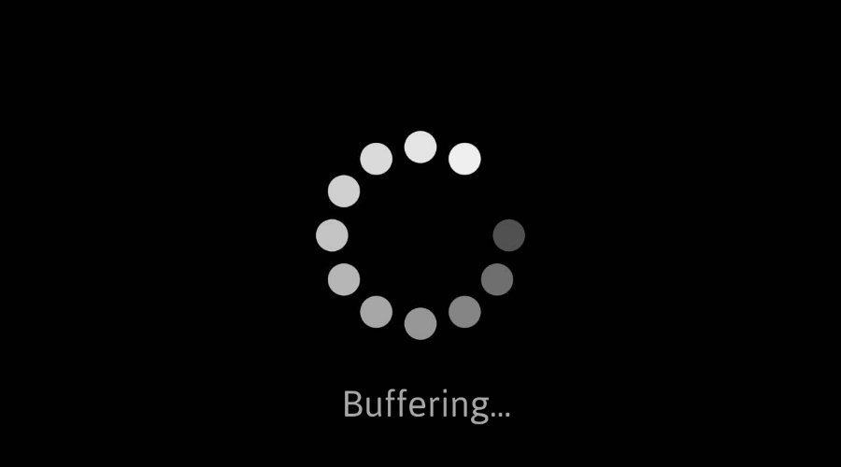
Streaming stored video: challenges
continuous playout constraint: during client video playout, playout timing must match original timing
  … but network delays are variable (jitter), so will need client-side buffer to match continuous playout constraint
other challenges:
  client interactivity: pause, fast-forward, rewind, jump through video
  video packets may be lost, retransmitted

Slide 60


Content distribution networks (CDNs)
challenge: how to stream content (selected from millions of videos) to hundreds of thousands of simultaneous users?
option 2: store/serve multiple copies of videos at multiple geographically distributed sites (CDN)
  enter deep: push CDN servers deep into many access networks
    close to users
    Akamai: 240,000 servers deployed
    in > 120 countries (2015)
  bring home: smaller number (10’s) of larger clusters in POPs near access nets
    used by Limelight
Notes:
Pop - point of presence

Slide 61




Content distribution networks (CDNs)
CDN: stores copies of content (e.g. MADMEN) at CDN nodes
subscriber requests content, service provider returns manifest
  using manifest, client retrieves content at highest supportable rate
  may choose different rate or copy if network path congested
…
…
…
where’s
Madmen?
manifest file
…
…
…
Notes:
61
Akamai: 100,000+ servers in 1000+ clusters in 1000+ networks in 70+ countries serving trillions of requests a day.
How many people use Netflix?

Slide 62
Content distribution networks (CDNs)
OTT: “over the top”
…
…
Internet host-host communication as a service
…
OTT challenges: coping with a congested Internet from the “edge”
  what content to place in which CDN node?
  from which CDN node to retrieve content? At which rate?
…
…
…
Notes:
62
peak load: 7million viewers, 2 Tbytes via

Slide 63
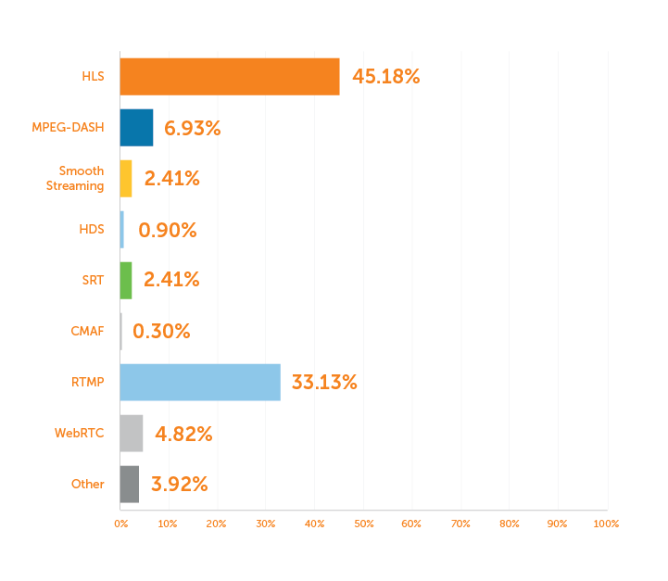
Streaming Protocols https://www.fullstack-dataengineer.dev/scaling-video-delivery-how-netflix-and-hulu-leveraged-a-similar-architecture-to-serve-millions-of-users-worldwide/
Traditional:
  RTMP – Real Time Messaging Protocol (Used widely as first mile carrier)
  RTSP - Real Time streaming Protocol (used widely in CCTV and Security)
HTTP Based
  Apple HLS – (Almost all devices supported)
  MPEG-DASH (Open source alternative to Apple HLS)
  MS Smooth Streaming – (used with Silverlight – not commonly used overall)
Newer
  SRT
  WebRTC
Measurement Study of CDNs
  https://www.moritzsteiner.de/papers/netflix-hulu.pdf
Notes:
https://www.wowza.com/blog/streaming-protocols#hls

